Slide 1

Statistical Analysis - Dementia
By Kristan Espinosa

Slide 2


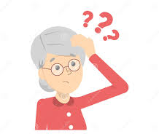


Introduction
Dementia is a progressive disease that affects the brain
Symptoms of Dementia includes:
Memory Loss
Confusion
Coordination/
Movement
Issues
Communication
Issues
Psychological
Issues

Slide 3
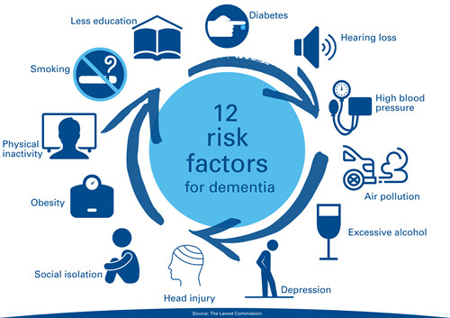
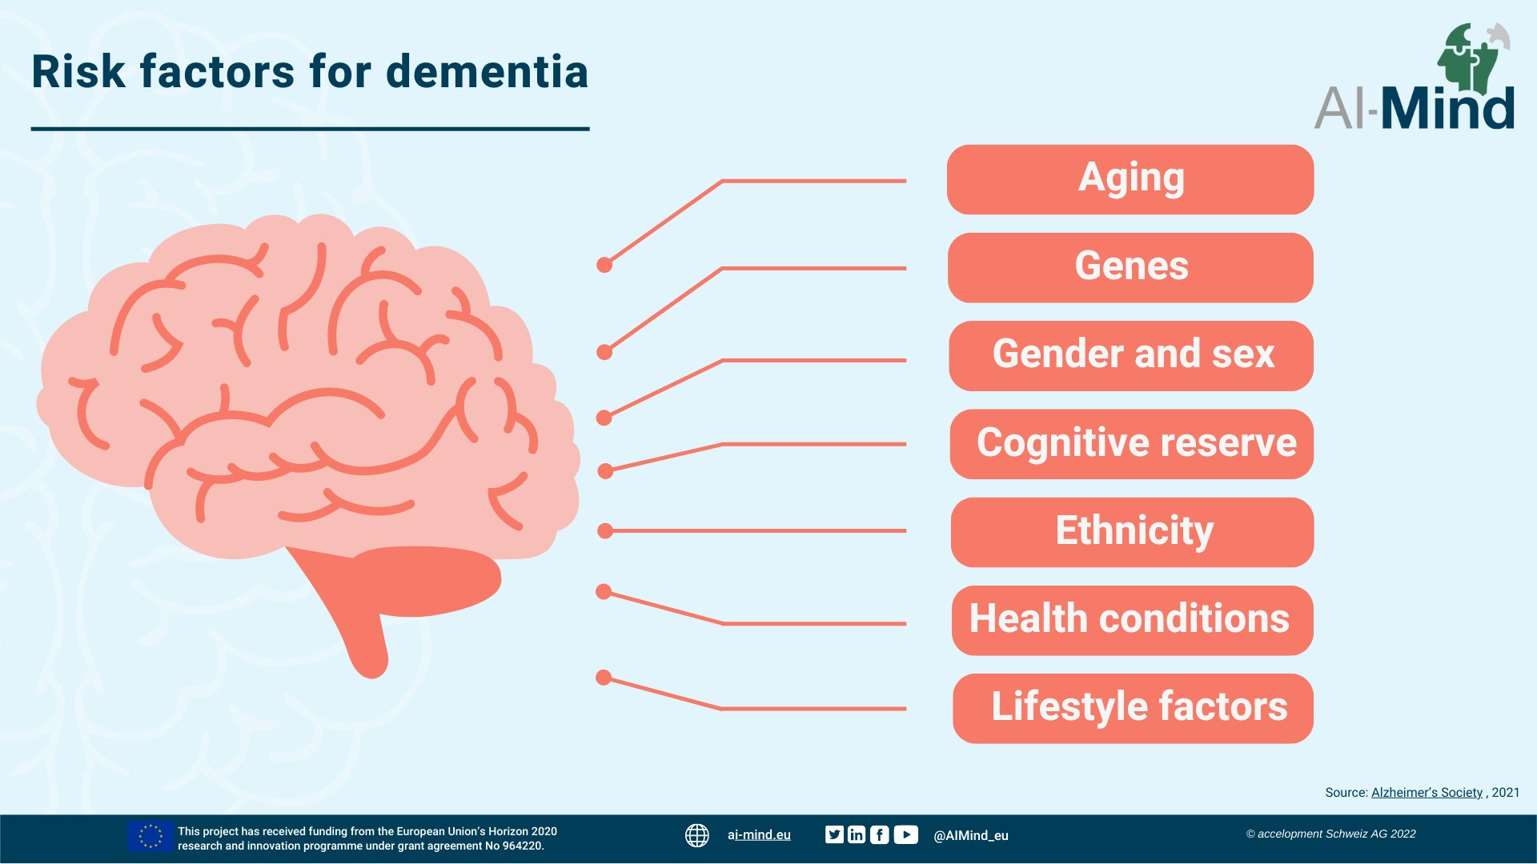
Introduction
Alzheimers New Zealand: https://alzheimers.org.nz/about-dementia/reducing-the-risk
Dementia is a complex disease

Slide 4

Data Set
Open Access Series of Imaging Studies (OASIS)
Cross-sectional study
Subjects recruited by Washington University through media appeals and word of mouth

Slide 5
Data Set (Variables)
Demographics
Gender (M/F)
Age
Education (Educ)
Socioeconomic status (SES)
Clinical
Mini-Mental State Examination (MMSE)
Brain Measurement
Estimated total intracranial volume (eTIV) (mm3)
Atlas scaling factor (ASF)
Normalized whole brain volume (nWBV)
Clinical Dementia Rating (CDR)

Slide 6
Data Set (Variables)
Demographics
Gender (M/F)
Age
Education (Educ)
Socioeconomic status (SES)
Clinical
Mini-Mental State Examination (MMSE)
Brain Measurement
Estimated total intracranial volume (eTIV) (mm3)
Atlas scaling factor (ASF)
Normalized whole brain volume (nWBV)
Clinical Dementia Rating (CDR)

Slide 7
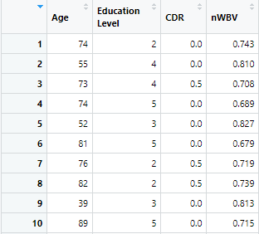
Data Set
Clinical Dementia Rating (CDR)
A rating to determine dementia status
0 = No Dementia
0.5 = Very mild
1 = Mild
2 = Moderate
3 = Severe
Non-Demented group
Demented group

Slide 8
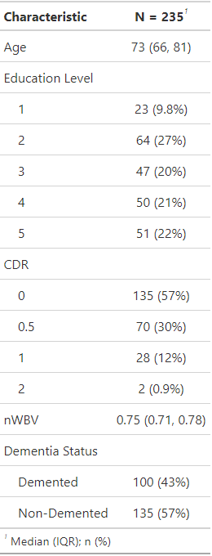
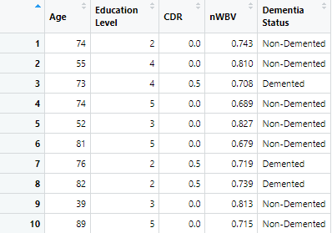

Data Set

Slide 9
Age Analysis
Is there any differences between the mean age of the demented group vs. the non-demented group?
H₀ = There is no difference between the mean age of the demented group vs. the non-demented group
H₁ = There is a difference between the mean age of the demented group vs. the non-demented group

Slide 10
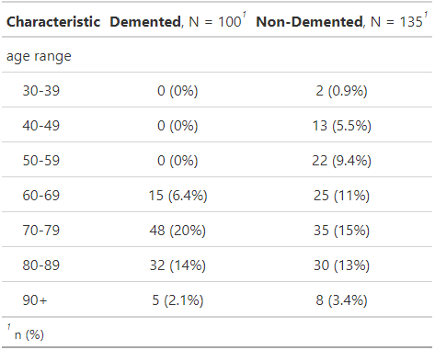
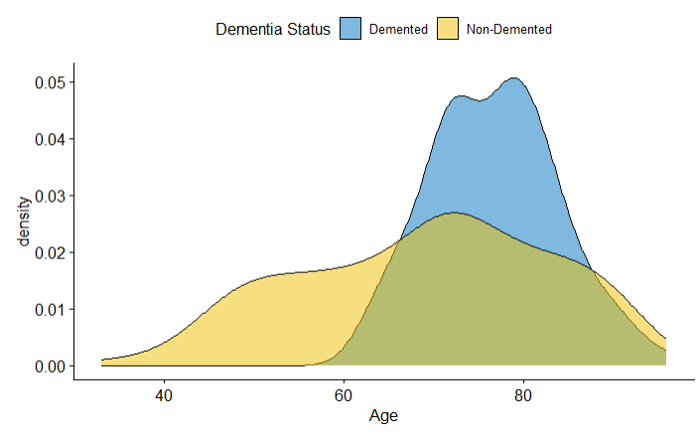
Age Analysis

Slide 11
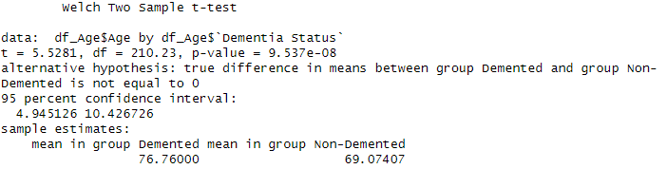
Age Analysis
We have evidence against the H₀ in favour of H₁
The observed difference between the two means, 7.7 is significant at the 5% level of significance
With 95% confidence we estimate that the mean age of the demented group is within 4.9 and 10.4 higher than the non-demented group
In conclusion, the mean age of the demented group is higher than the non-demented group

Slide 12
Education Level Analysis
1: less than high school graduate
2: high school graduate
3: some college
4: college graduate
5: beyond college.

Slide 13
Education Level Analysis
Is there any differences between the mean education level of the demented group vs. the non-demented group?
H₀ = There are no difference between the mean education level of the demented group vs. the non-demented group
H₁ = There is a difference between the mean education level of the demented group vs. the non-demented group

Slide 14
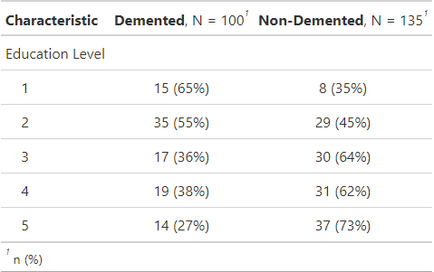
Education Level Analysis
Education Level 1 & 2 (High-School): There is a higher proportion of the Demented group
Education Level 3-5 (College): There is a higher proportion of the Non-demented group

Slide 15
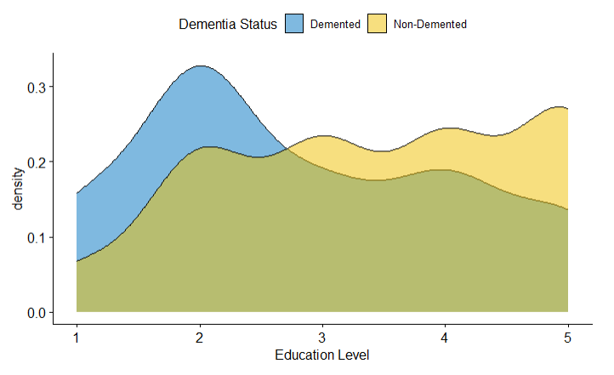
Education Level Analysis

Slide 16
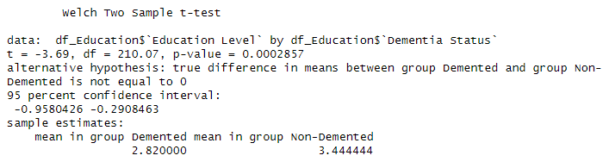
Education Level Analysis
We have evidence against the H₀ in favour of H₁
The observed difference between the two means, 0.62 is significant at the 5% level of significance
With 95% confidence we estimate that the mean education level of the demented group is between 0.96 and 0.29 lower than the non-demented group

Slide 17
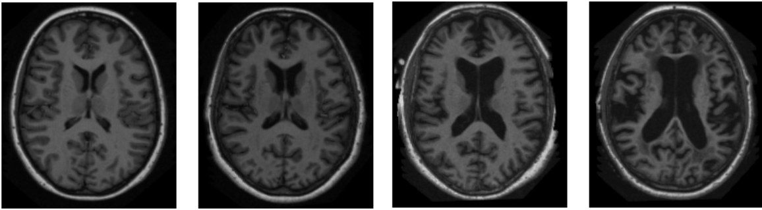
Normalized whole brain volume (nWBV)
Participant’s brain were imaged using T1 MRI
nWBV corresponds to the proportion of brain tissue within the skull
nWBV accounts for individual variations in brain size

Slide 18
nWBV Analysis
Is there any differences between the mean nWBV of the demented group vs. the non-demented group?
H₀ = There are no difference between the mean nWBV of the demented group vs. the non-demented group
H₁ = There is a difference between the mean nWBV of the demented group vs. the non-demented group

Slide 19
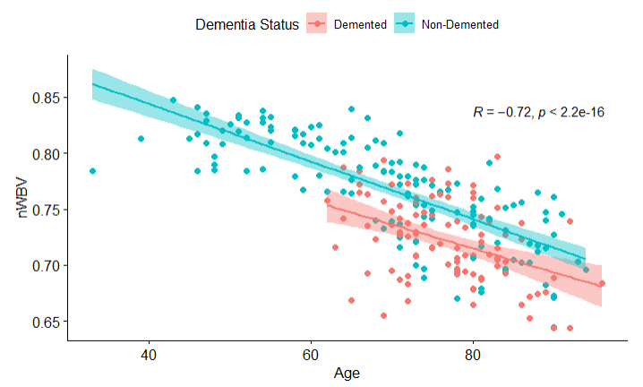
nWBV Analysis
There is a strong negative correlation between nWBV and age

Slide 20
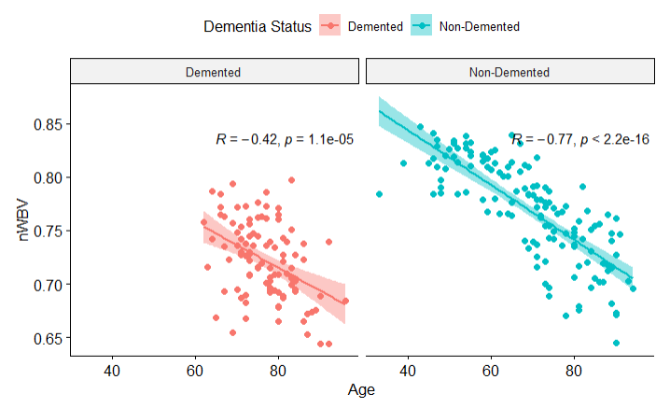
nWBV Analysis

Slide 21
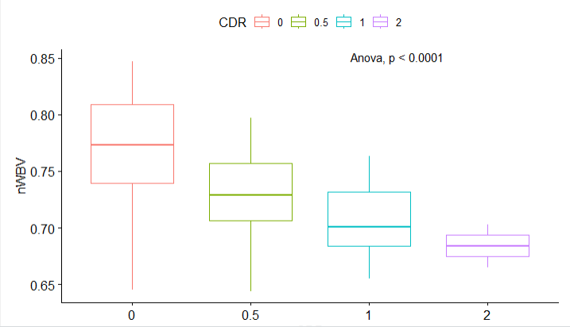
nWBV Analysis

Slide 22
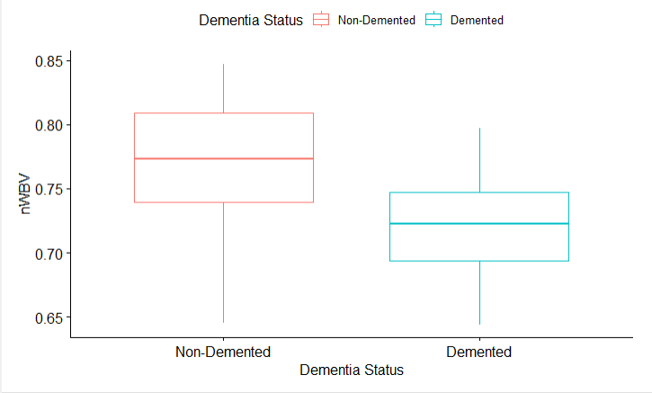
nWBV Analysis

Slide 23
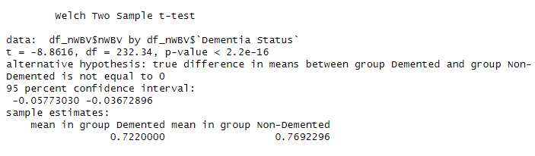
nWBV Analysis
We have evidence against the H₀ in favour of H₁
The observed difference between the two means, 0.05 is significant at the 5% level of significance
With 95% confidence we estimate that the mean nWBV of the demented group is between 0.06 and 0.04 lower than the non-demented group

Slide 24
Conclusion
Findings
Research
•
Dementia is common among older
•
It is rare for an older individual to have
people.
a disease
-
free brain.
•
Reduction in brain volume with
•
The ageing effect on the brain is
increasing age
progressive and irreversible
(Azam et.al, 2021)
•
Lower education is more common
•
A study conducted in Japan shows that
within the demented group
older people living in areas with low
education level is more likely to
develop dementia (
Takasugi
et.al,
2021)
•
Cognitive Reserve theory (Stern,
2013)
•
Reduction in brain volume with
•
Dementia damages neurons that leads
dementia
to brain atrophy (Smith, 2002)

Slide 25
Conclusion
Limitation
Cross-sectional study – difficult to imply causation
Future Work
Other risk factors of dementia (e.g. Hearing loss)
Investigate causational relationship

Slide 26

References
Azam S, Haque ME, Balakrishnan R, Kim IS, Choi DK. (2021). The Ageing Brain: Molecular and Cellular Basis of Neurodegeneration. Front Cell Dev Biol.
Marcus DS, Fotenos AF, Csernansky JG, Morris JC, Buckner RL. (2010). Open Access Series of Imaging Studies (OASIS): Cross-sectional MRI Data in Young, Middle Aged, Nondemented, and Demented Older Adults. J Cogn Neurosci.22(12):2677-84.
Smith AD. (2002). Imaging the progression of Alzheimer pathology through the brain. Proc Natl Acad Sci U.S A. 99(7):4135-7.
Stern Y. (2012). Cognitive reserve in ageing and Alzheimer's disease. Lancet Neurol. 11(11):1006-12.
Takasugi, T., Tsuji, T., Hanazato, M. et al. (2021). Community-level educational attainment and dementia: a 6-year longitudinal multilevel study in Japan. BMC Geriatr 21, 661.

